Slide 1
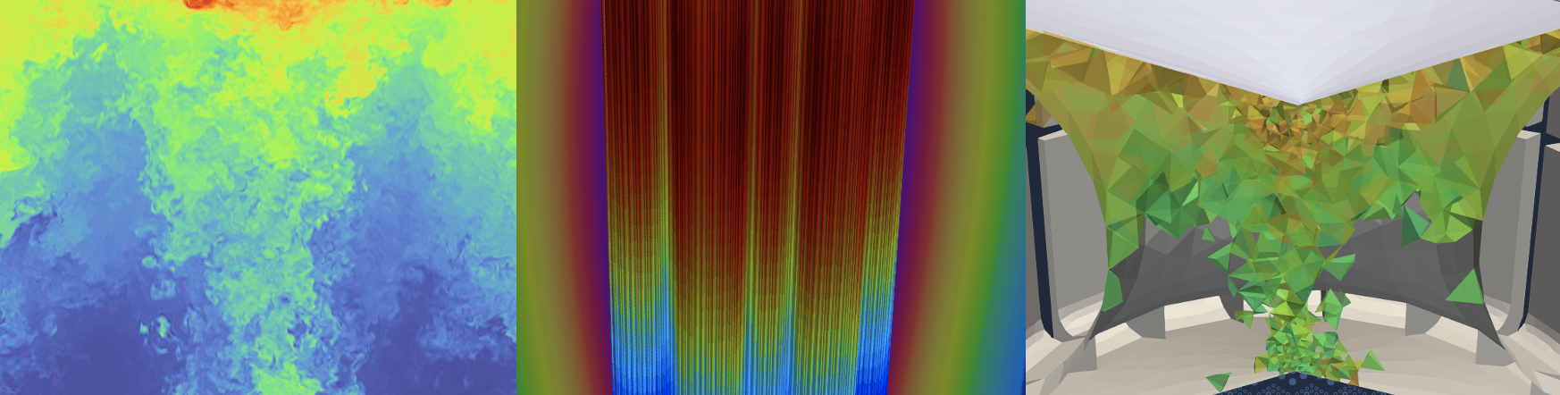
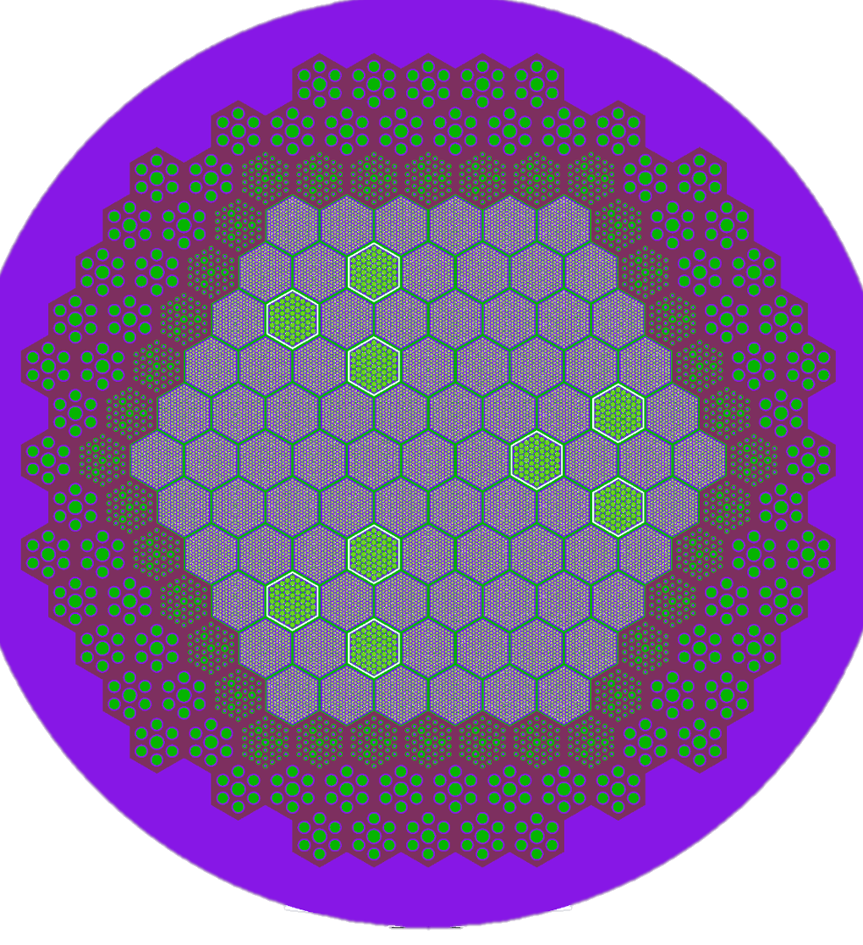
NekRS: Spectral Element Computational Fluid Dynamics (CFD)
April Novak
Assistant Professor
Nuclear, Plasma, and Radiological Engineering (NPRE)
University of Illinois, Urbana-Champaign
Joint Appointment, Nuclear Science and Engineering (NSE) Division
Argonne National Laboratory

Slide 2
(Re)-Introduction to Cardinal and NekRS (15 min)
Flow over a pebble (75 min):
Laminar/Direct Numerical Simulation (DNS)
Large Eddy Simulation (LES)
Notes:
complementary to experimental programs

Slide 3
Objectives:
Introduce how to build, run, and postprocess NekRS simulations
Assumptions:
Basic familiarity with Unix-based environment
Basic experience with C++
Basic familiarity with thermal-fluid modeling
Notes:
complementary to experimental programs

Slide 4
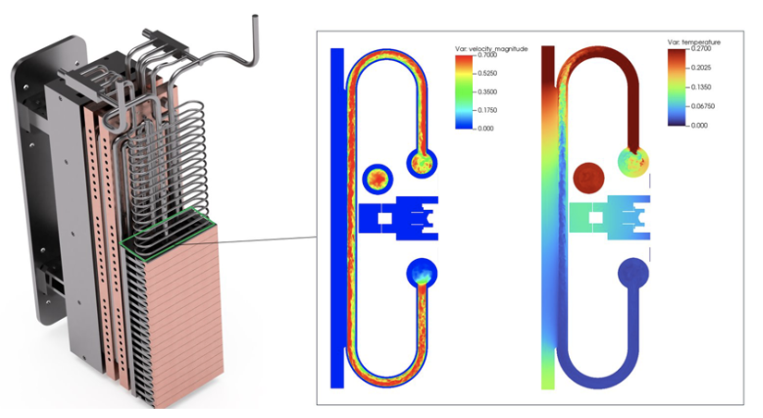
Cardinal
Couples the NekRS computational fluid dynamics code to MOOSE
Open source, extensible for research purposes
Adopt best practices for software development
High performance, scalable on HPC
Can be used to predict:
Heat transfer and fluid flow
Temperature and heat flux thermal limits
Pressure losses and pumping power
Passive scalar transport (e.g., mass transport)
Magnetohydrodynamics
Fluid-structure interaction
and how these are influenced by OTHER PHYSICS
Velocity and temperature in CHIMERA
Simulations performed by Kirk Yuan (ANL), Tri Nguyen (PSU), Elia Merzari (PSU), and Yu-Hsiang Lan (UIUC)

Slide 5
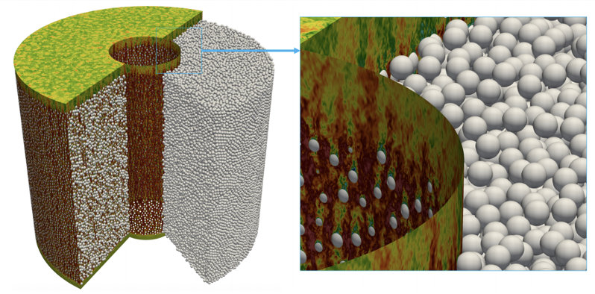
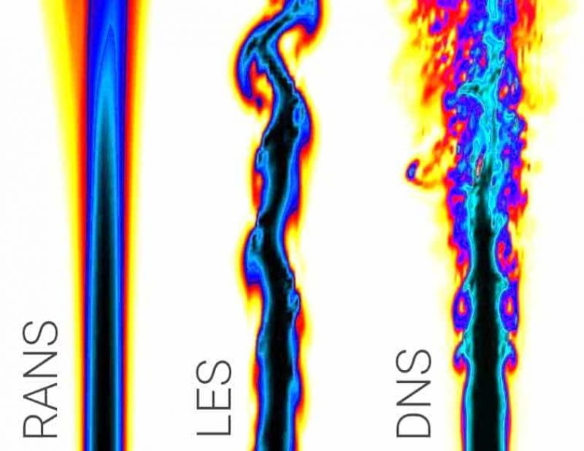
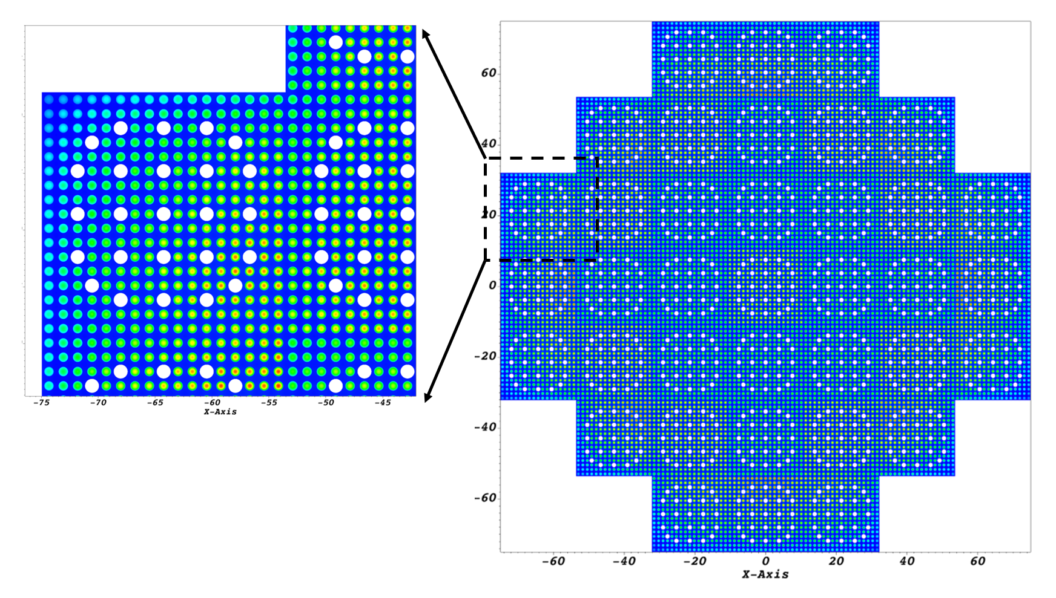
NekRS
NekRS LES simulation of a pebble bed reactor (M. Min, ANL)
Spectral element Navier-Stokes solver
RANS, LES, and DNS turbulence models
Arbitrary number of passive scalars
Incompressible flow or low Mach flow
Incompressible MHD under development
Runs on CPUs and GPUs; uses OCCA for portability
idealsimulations.com
NekRS RANS simulation of a light water reactor (J. Fang, ANL)

Slide 6
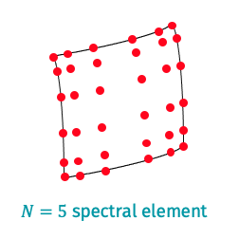
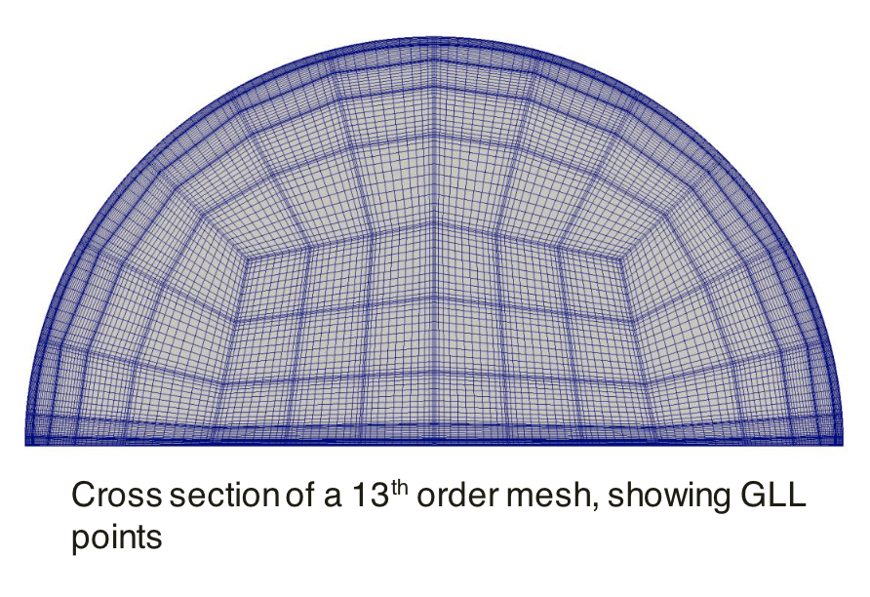
NekRS
Spectral elements divide each element according to Gauss-Lobatto-Legendre (GLL) quadrature
Solution is continuous across the entire domain
High-order spatial approximation (7th order is a common choice, but p-refinement is straightforward)
No steady state solver – all solves are transients or pseudo-transients

Slide 7
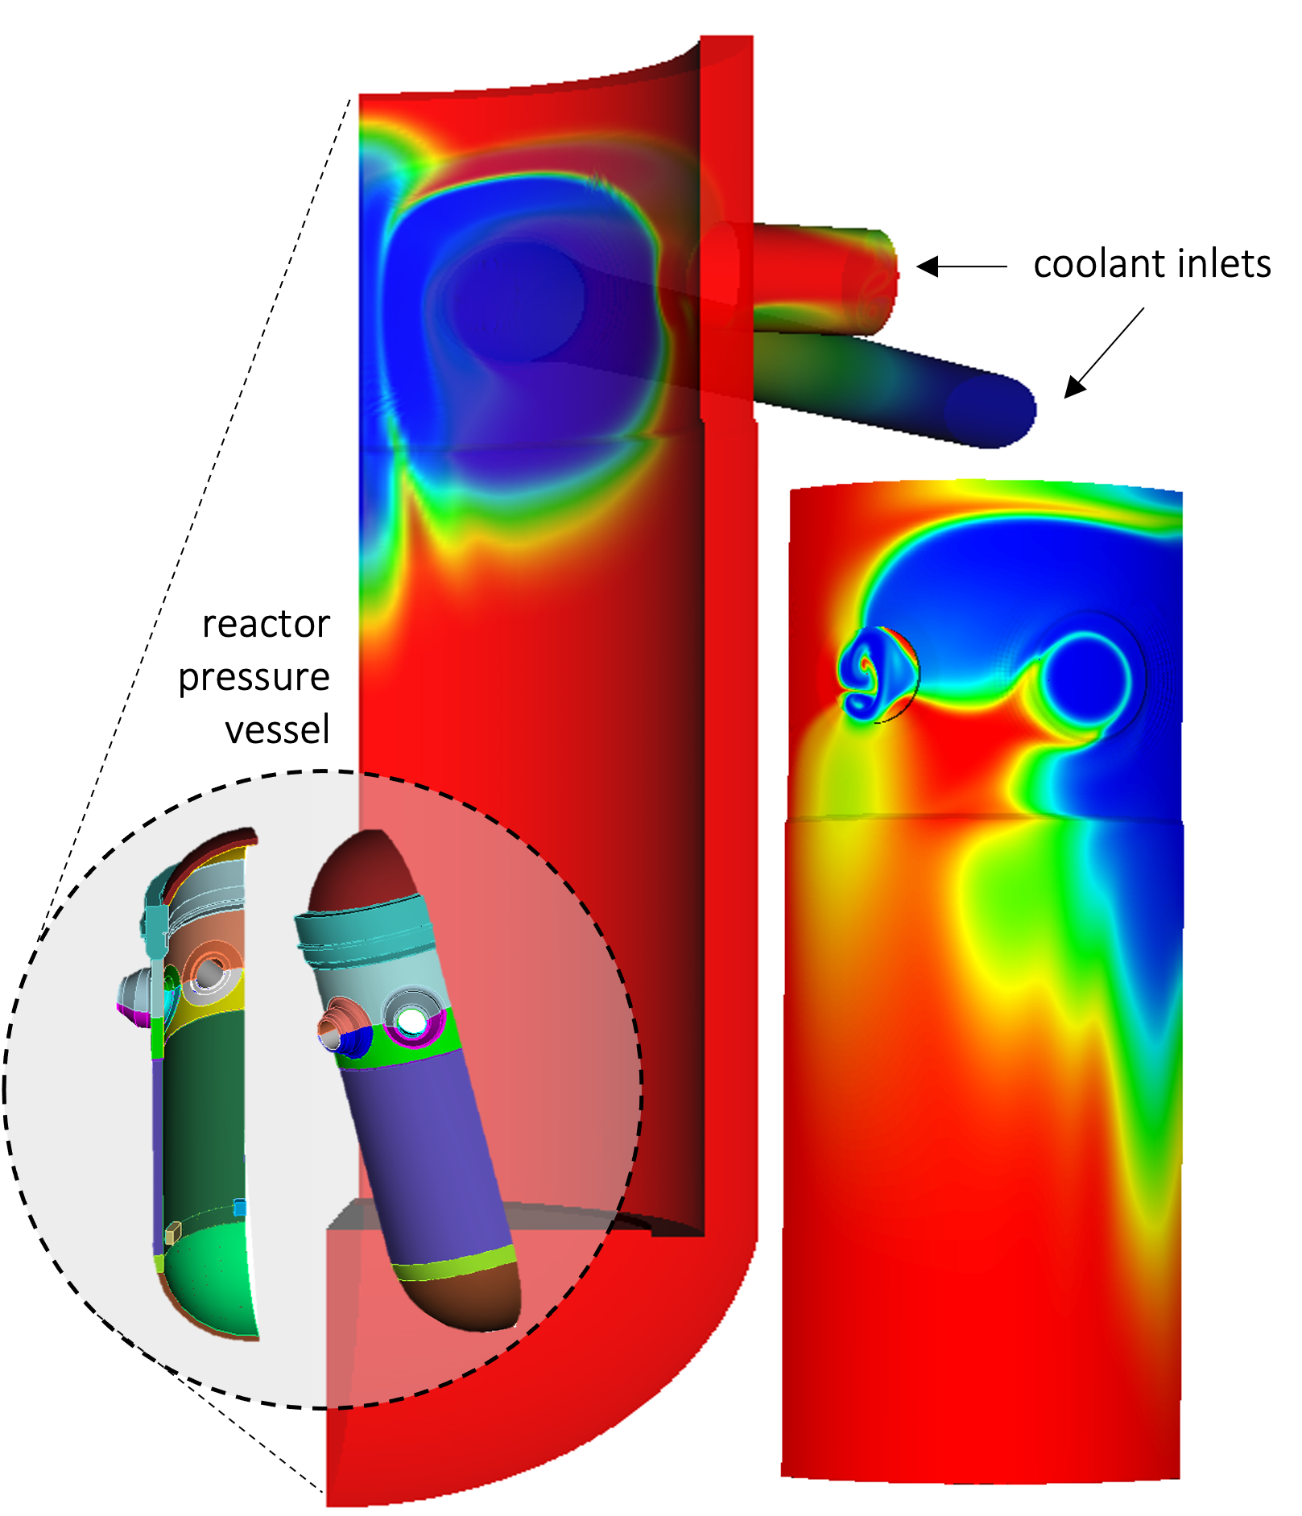
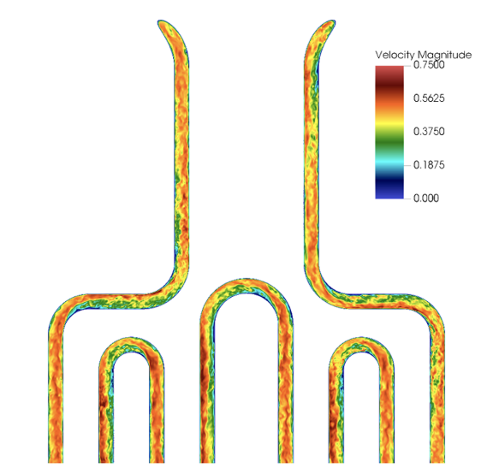
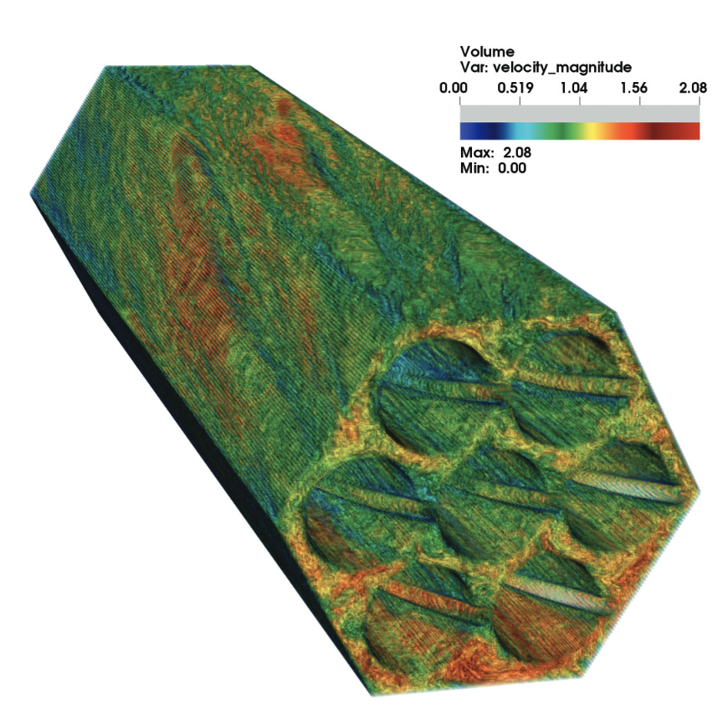
NekRS
Turbulence models: DNS, RANS, LES
DNS flow (including laminar)
RANS flow
LES flow
Fission reactor
Carolina Bourdot Dutra (PSU)
Fission reactor
Yiqi Yu (ANL)
CHIMERA
Kirk Yuan (ANL), Tri Nguyen (PSU), Elia Merzari (PSU), and Yu-Hsiang Lan (UIUC)

Slide 8
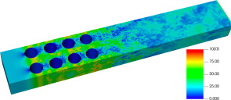
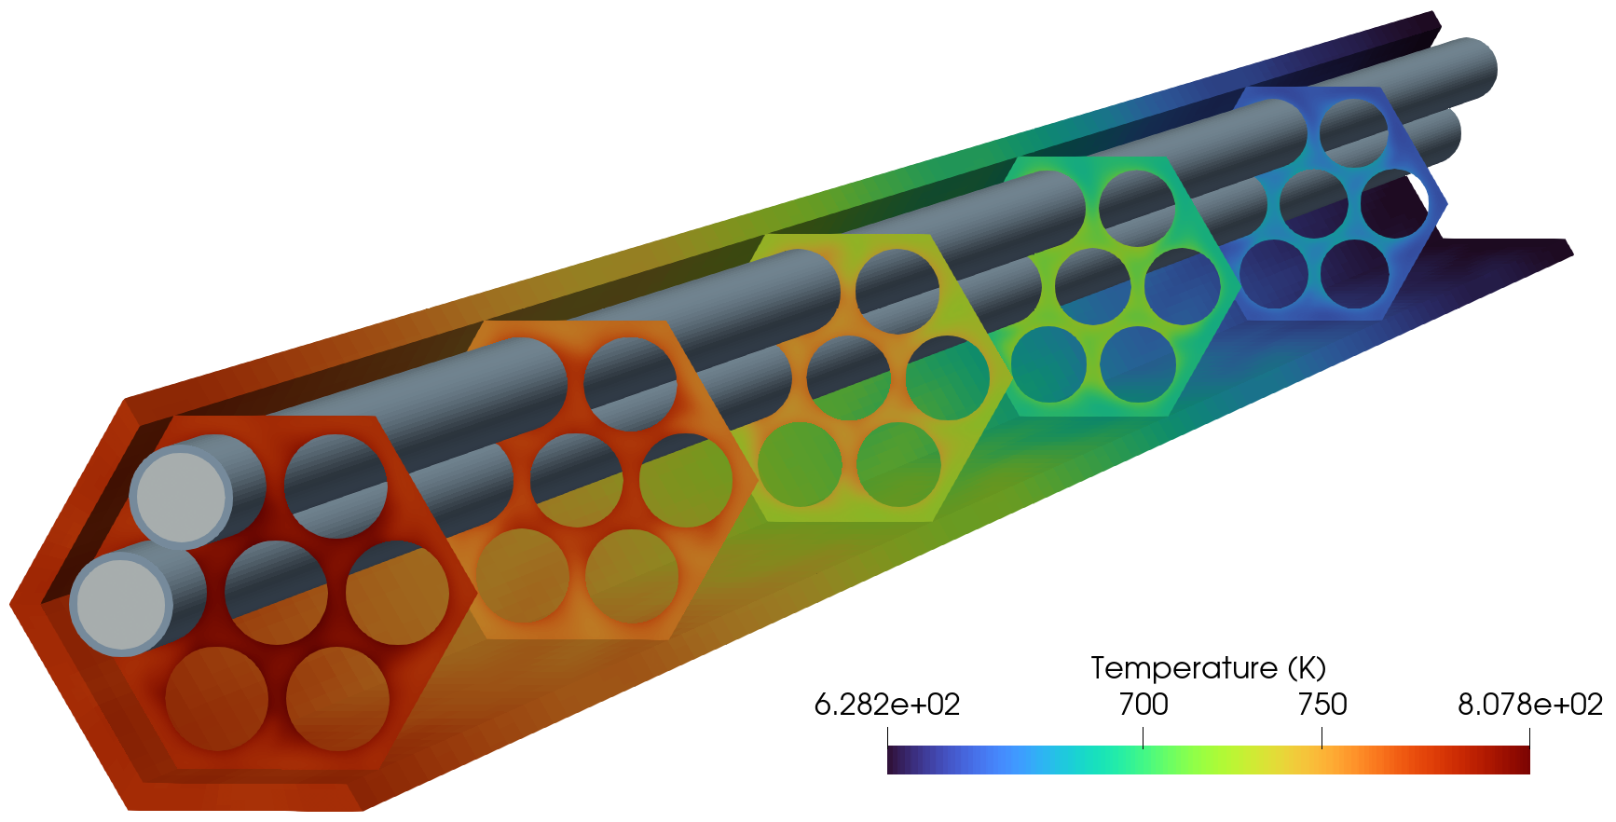
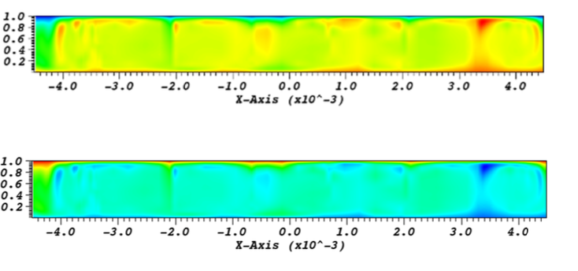
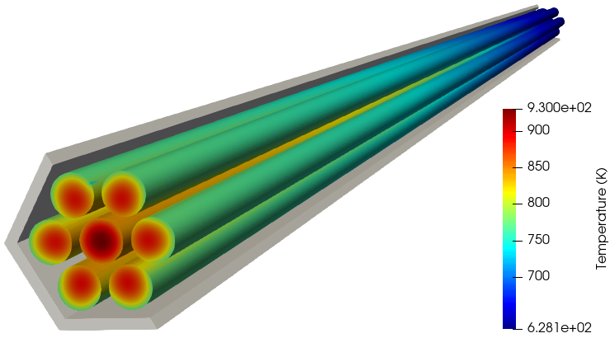
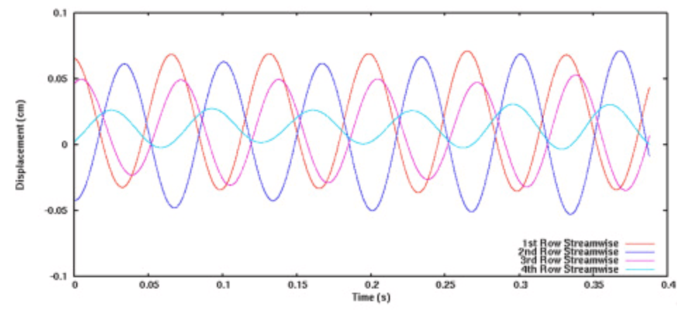
NekRS
Turbulence models: DNS, RANS, LES
Features: conjugate heat transfer, passive scalar transport, fluid-structure interaction, custom physics and properties
Conjugate heat transfer
Passive scalar transport
Fluid-structure interaction
Tube vibrations
Landon Brockmeyer (ANL)
Fission reactor
Mass transport
Haomin Yuan (ANL)

Slide 9
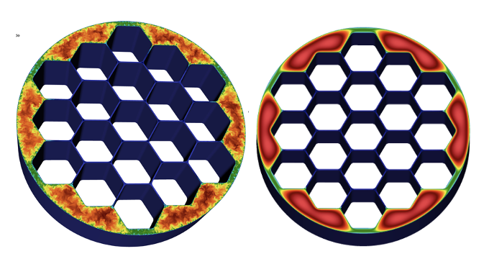
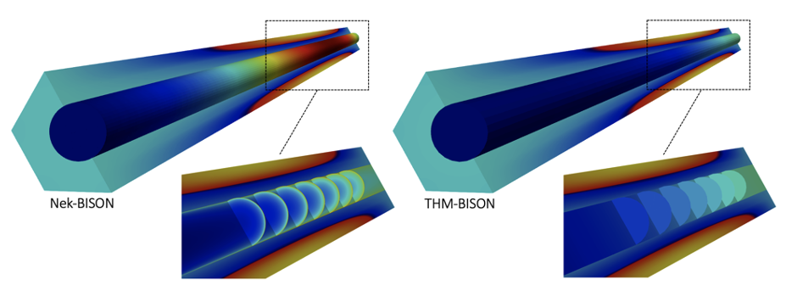
NekRS
Turbulence models: DNS, RANS, LES
Features: conjugate heat transfer, passive scalar transport, fluid-structure interaction, custom physics and properties
Postprocessing: time-averaging, constitutive models, custom operations
Time-averaging
Constitutive models
Fission reactor
Heat transfer coefficient

Slide 10
NekRS
Turbulence models: DNS, RANS, LES
Features: conjugate heat transfer, passive scalar transport, fluid-structure interaction, custom physics and properties
Postprocessing: time-averaging, constitutive models, custom operations
Parallelism: MPI on CPU, MPI on GPU

Slide 11
Docker Instructions
To test if Docker works:
cd openmc/live
cardinal-opt -i testing.i

Slide 12
Compiling Cardinal (After the workshop!)
git clone https://github.com/neams-th-coe/cardinal.git
cd cardinal
./scripts/get-dependencies.sh
./contrib/moose/scripts/update_and_rebuild_petsc.sh ./contrib/moose/scripts/update_and_rebuild_libmesh.sh ./contrib/moose/scripts/update_and_rebuild_wasp.sh
export NEKRS_HOME=$HOME/cardinal/install/bin
make -j8
Compile all dependencies with a single make command, which gives you:
Cardinal executable (cardinal/cardinal-opt)
“standalone” OpenMC executable (cardinal/build/openmc/bin/openmc)
“standalone” NekRS executable (cardinal/install/bin/nrsmpi)
Nek5000 tools (exo2nek) are used to prepare meshes:
git clone https://github.com/Nek5000/Nek5000.git
cd Nek5000/tools
./maketools exo2nek
download the Cardinal source code
download the OpenMC and NekRS
source code
build MOOSE 3rd-party dependencies
set environment variable
compile Cardinal

Slide 13
How to Get Involved
Git repository:
Cardinal: https://github.com/neams-th-coe/cardinal
NekRS: https://github.com/Nek5000/nekRS
Discussions page:
Cardinal: https://github.com/neams-th-coe/cardinal/discussions
NekRS: https://github.com/Nek5000/nekRS/discussions
Documentation:
Cardinal: https://cardinal.cels.anl.gov/
NekRS: https://nekrsdoc.readthedocs.io
Contact us directly!
April Novak: ajnovak2@Illinois.edu (Cardinal lead)
Dillon Shaver: dshaver@anl.gov (Nek lead)

Slide 14
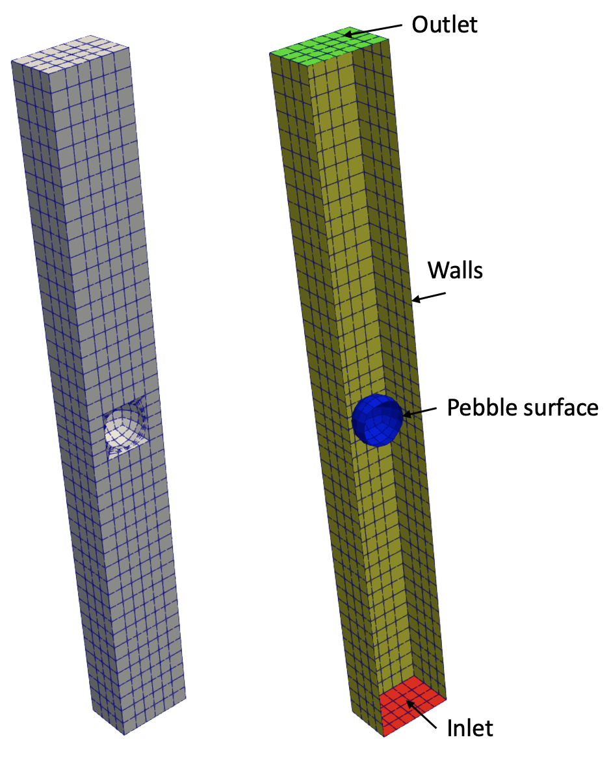
Example: Flow Over a Pebble
Link: https://cardinal.cels.anl.gov/tutorials/nek_intro.html
pebble diameter: 3 cm
box dimensions: 5 cm x 5 cm x 43 cm
helium fluid
Intro to Direct Numerical Simulation (DNS) (45 min)
Intro to Large Eddy Simulation (LES) (30 min)
Objectives:
How to set up NekRS input files for different turbulence modeling choices
How to build NekRS input files in dimensional and non-dimensional form
How to generate a mesh for NekRS
How to visualize NekRS output files

Slide 15
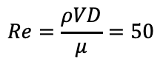
Example: Flow Over a Pebble
Link: https://cardinal.cels.anl.gov/tutorials/nek_intro.html
pebble diameter: 3 cm
box dimensions: 5 cm x 5 cm x 43 cm
helium fluid
Intro to Direct Numerical Simulation (DNS) (45 min)
Intro to Large Eddy Simulation (LES) (30 min)
$$Re=\frac{ρVD}{μ}=50$$

Slide 16
NekRS Input Files
<case>.re2: mesh (Hex8 or Hex20)
<case>.par: high-level settings for the equations, time stepping, I/O, …
<case>.oudf: OKL-language “kernels” that run on “backend” (e.g. GPU)
boundary conditions
any other user-specified physics
<case>udf: C++ user interaction which runs on the “host” (e.g. CPU)
initial conditions
postprocessing
pass stuff between device (GPU) and host (CPU)
Optional:
<case>.usr: Fortran backend to access Nek5000 features
A note on naming conventions:
o_name and name hold the same data, but o_name is on the device (GPU) whereas name is on the host (CPU)

Slide 17
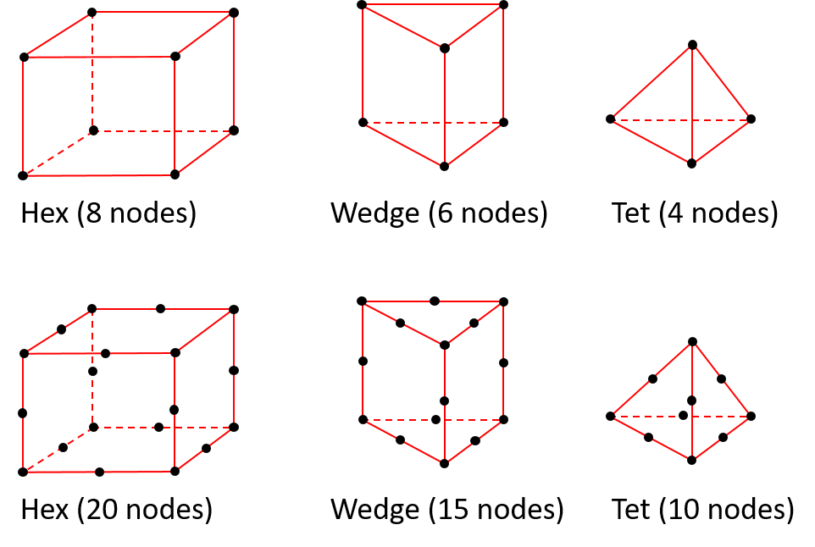
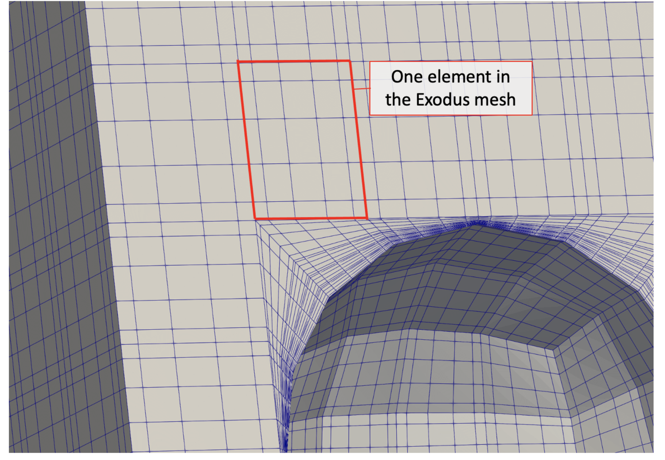
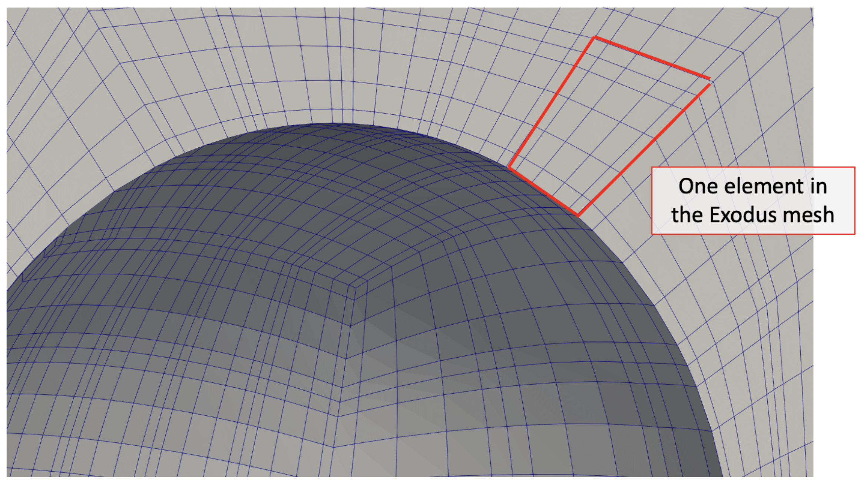
Hex8 vs Hex20 Meshes
NekRS mesh can be either Hex8 (first-order) or Hex20 (second-order)
exo2nek will automatically convert tet/prism elements accordingly
Hex20: if the mid-side nodes are on a curve, NekRS will also put the other GLL points on a quadratic
Hex8

Slide 18
Geometry: pebble.exo
The mesh Nek uses internally
Mesh must be 3-D
Sidesets must be numbered consecutively, beginning from 1
1: inlet
2: outlet
3: pebble surface
4: walls
The mesh you create

Slide 19
Convert to NekRS mesh format: ~/Nek5000/bin/exo2nek

Slide 20
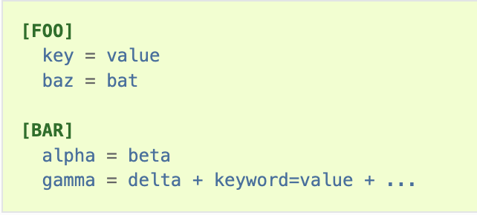
Parameter settings: pebble.par
High-level settings for solver, boundary conditions, and equations to solve
Comprehensive list of syntax:
~/cardinal/install/bin/nekrs --help par

Slide 21
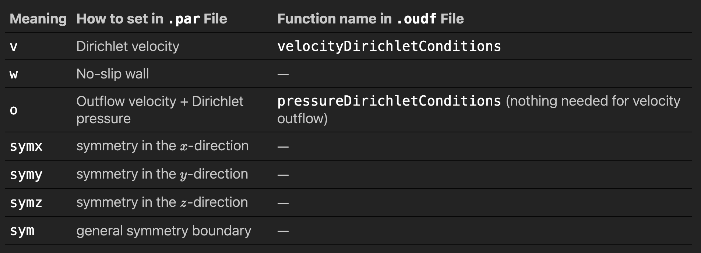
Parameter settings: pebble.par
Boundary conditions are specified using character symbols

Slide 22
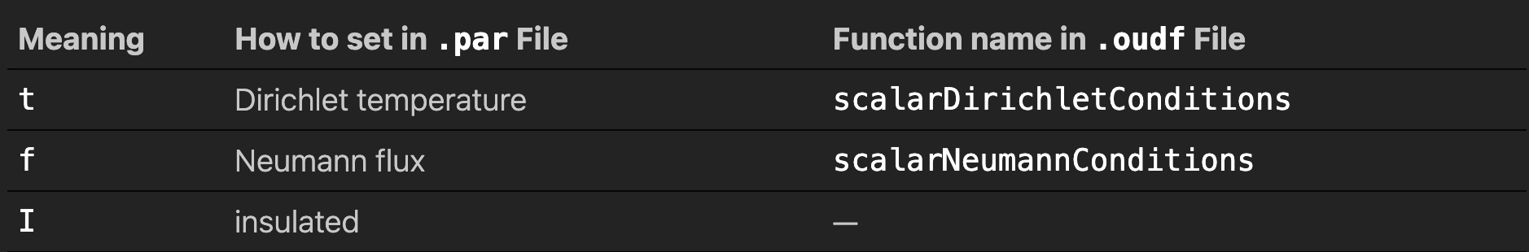
Parameter settings: pebble.par
Boundary conditions are specified using character symbols

Slide 23
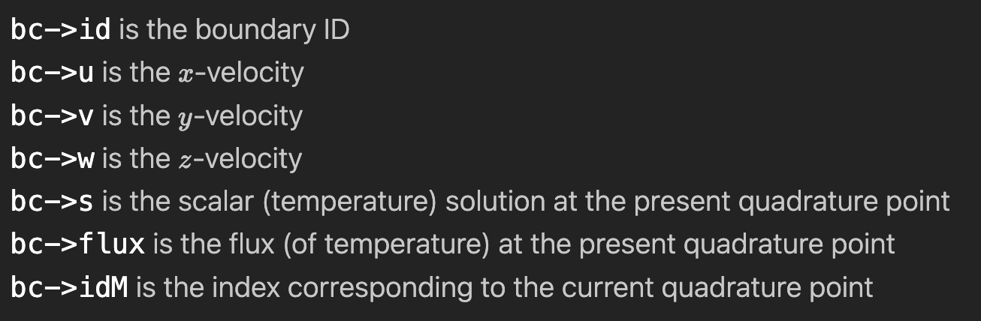
Kernels and boundary conditions: pebble.oudf
Boundary conditions are specified using kernels connected to the choices made in the .par file

Slide 24
Initial conditions and user interfaces: pebble.udf
UDF_LoadKernels will load any user-defined physics kernels
UDF_Setup is called on initialization, typically where initial conditions are applied
UDF_ExecuteStep is called each time step, typically where postprocessing is applied
Commonly-used variables: https://nekrsdoc.readthedocs.io/en/latest/commonly_used_variables.html

Slide 25
Legacy backend: pebble.usr
Fortran file to perform custom user actions - will eventually be deprecated, but still widely used to streamline porting from Nek5000 to NekRS

Slide 26
Running
Both of these commands will run the NekRS simulation. Within the Docker container, we’ve only set up the Cardinal executable.
cardinal/install/bin/nrsmpi pebble 4
mpiexec –np 4 cardinal-opt –i nek.i

Slide 27
Viewing Output Files
~/cardinal/scripts/visnek pebble

Slide 28
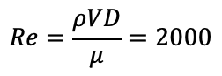
Example: Flow Over a Pebble
Link: https://cardinal.cels.anl.gov/tutorials/nek_intro.html
pebble diameter: 3 cm
box dimensions: 5 cm x 5 cm x 43 cm
helium fluid
Intro to Direct Numerical Simulation (DNS) (45 min)
Intro to Large Eddy Simulation (LES) (30 min)
$$Re=\frac{ρVD}{μ}=2000$$

Slide 29
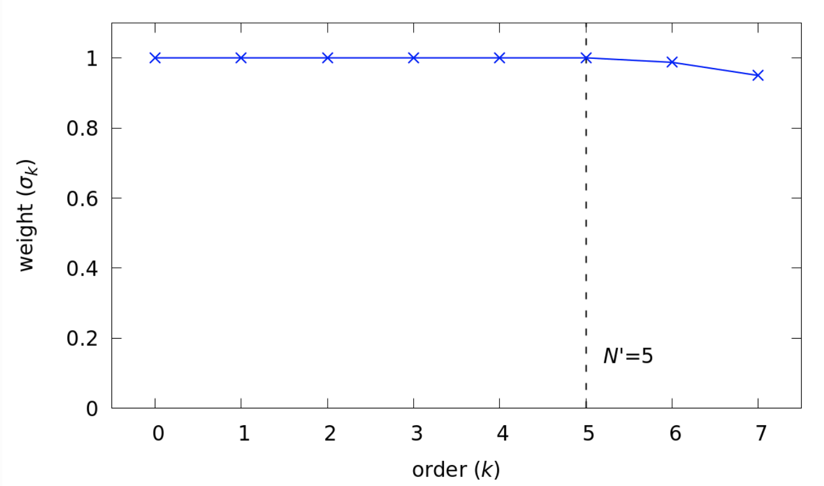
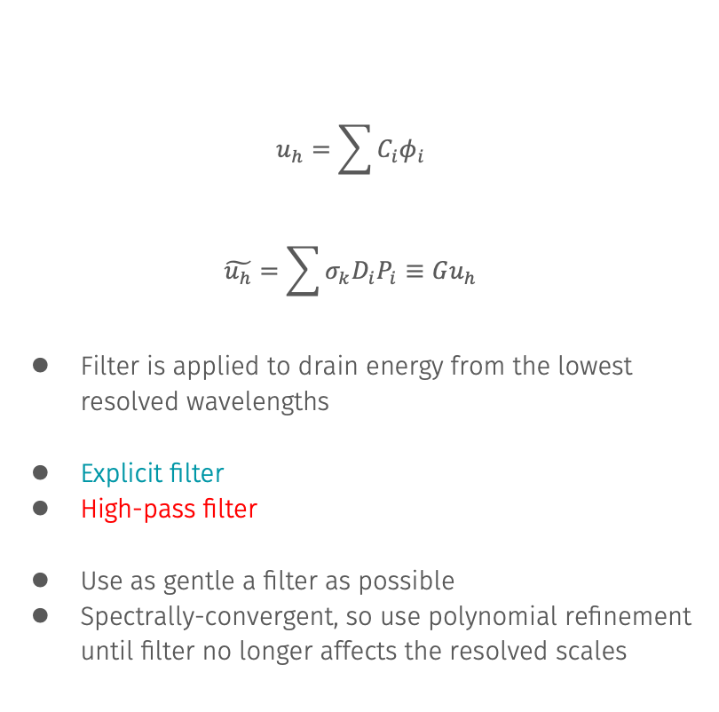
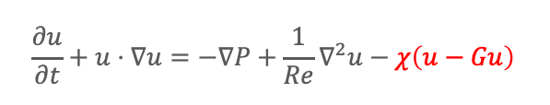
Large Eddy Simulation with NekRS
$$u_{h}=\sum{C_{i}φ_{i}}$$
$$\tilde{u_{h}}=\sum{σ_{k}D_{i}P_{i}}≡Gu_{h}$$
Filter is applied to drain energy from the lowest resolved wavelengths
Explicit filter
High-pass filter
Use as gentle a filter as possible
Spectrally-convergent, so use polynomial refinement until filter no longer affects the resolved scales
$$\frac{∂u}{∂t}+u⋅∇u=−∇P+\frac{1}{Re}∇^{2}u−χ\left(u−Gu\right)$$

Slide 30
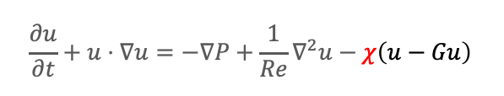
Parameter settings: pebble.par
[GENERAL]
regularization = hpfrt + nModes=2 + scalingCoeff=5
nModes
$$\frac{∂u}{∂t}+u⋅∇u=−∇P+\frac{1}{Re}∇^{2}u−χ\left(u−Gu\right)$$
scalingCoeff

Slide 31
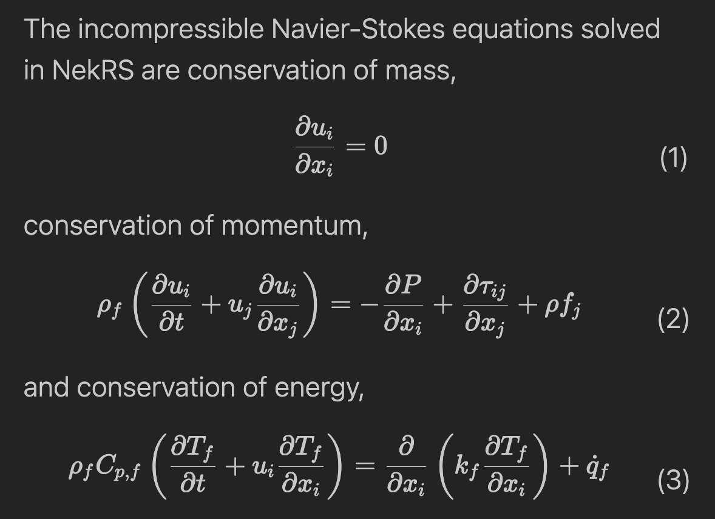
Non-Dimensional Navier-Stokes

Slide 32
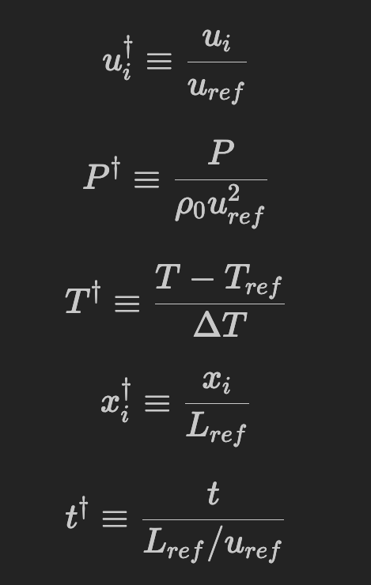
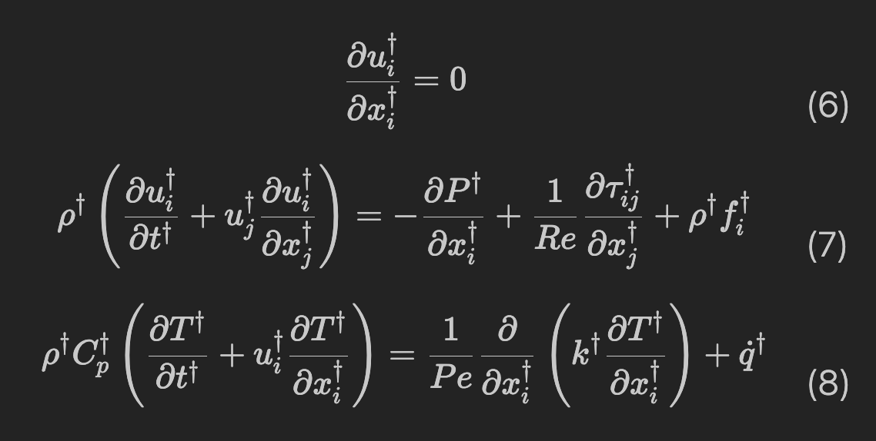
Non-Dimensional Navier-Stokes

Slide 33
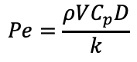
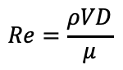
Non-Dimensional NekRS
Characteristic scales are enforced by:
Generating a mesh in non-dimensional units
Setting the ”material properties” appropriately
Any other C++ code should refer to non-dimensional units
$$Re=\frac{ρVD}{μ}$$
$$Pe=\frac{ρVC_{p}D}{k}$$

Slide 34
Scale the mesh: pebble.usr
If we choose the sphere diameter as our characteristic length, we need to non-dimensionalize the mesh by dividing all coordinates by 3 cm

Slide 35
Running
Both of these commands will run the NekRS simulation. Within the Docker container, we’ve only set up the Cardinal executable.
cardinal/install/bin/nrsmpi pebble 4
mpiexec –np 4 cardinal-opt –i nek.i

Slide 36
NekRS is a spectral element CFD solver providing high-fidelity turbulence modeling
Additional NekRS demos can be found in cardinal/contrib/nekRS/examples

Slide 37
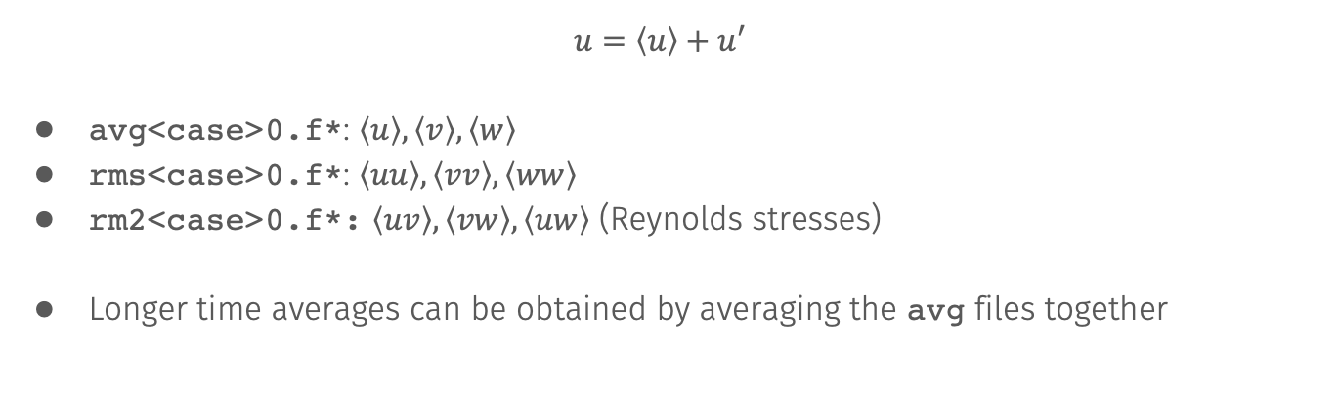
Turbulent Averaging: #include plugins/tavg.hpp
$$u=\left\langle u\right\rangle +u^{′}$$
avg<case>0.f*: $\left\langle u\right\rangle , \left\langle v\right\rangle , \left\langle w\right\rangle$
rms<case>0.f*: $\left\langle uu\right\rangle , \left\langle vv\right\rangle , \left\langle ww\right\rangle$
rm2<case>0.f*: $\left\langle uv\right\rangle , \left\langle vw\right\rangle , \left\langle uw\right\rangle$ (Reynolds stresses)
Longer time averages can be obtained by averaging the avg files together

Slide 38
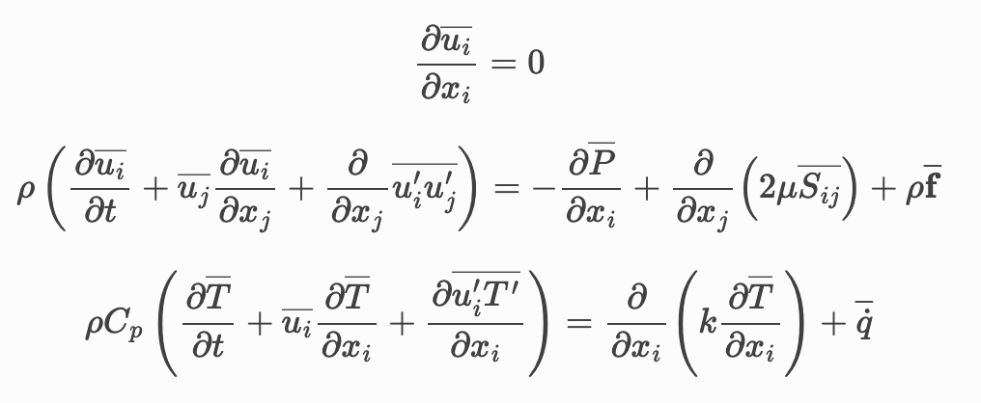
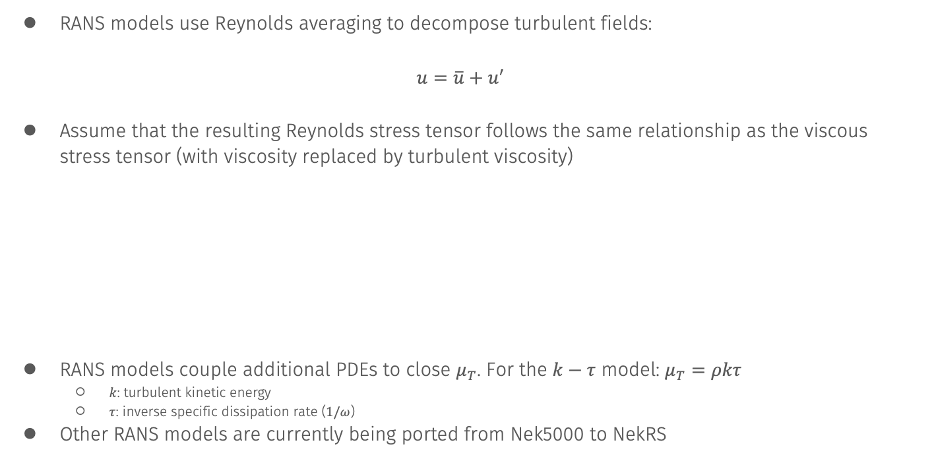
RANS Modeling with NekRS
RANS models use Reynolds averaging to decompose turbulent fields:
$$u=\overline{u}+u^{′}$$
Assume that the resulting Reynolds stress tensor follows the same relationship as the viscous stress tensor (with viscosity replaced by turbulent viscosity)
RANS models couple additional PDEs to close $μ_{T}$. For the $k−τ$ model: $μ_{T}=ρkτ$
$k$: turbulent kinetic energy
$τ$: inverse specific dissipation rate ($1/ω$)
Other RANS models are currently being ported from Nek5000 to NekRS

